Slide 1


Robotic Sorting System Pace Dominy, Joseph Miller, Lam Tran

Slide 2
Project description
Problem Statement: Sorting fruits at a farm takes trained workers and can take away from valuable time and money, especially for smaller farms.

Slide 3
Project description
Solution Proposal: Develop an automatic sorting system that requires limited manpower/oversight that can accurately sort fruit by their size and quality without the farmer having to do it themselves.

Slide 4
System Diagram
Maroon arrows denote physical inputs and outputs
Pace Dominy
Conveyor Belt
Robotic Levers
Individual Fruit Receptacles
Fruits
Control and Power Logic
System Control
Android Application
Sensors
Power Control
Joseph Miller
Lam Tran
Pace Dominy
Notes:
No “owner” for the Pi: we’re all using that
Note the separation between the physical “fruit flow” and the power and information flows
This shows a setup for two “bins”: can have more

Slide 5
Pace Dominy
Conveyor Belt
Robotic Levers
Individual Fruit Receptacles
Fruits
Control and Power Logic
System Control
Android Application
Sensors
Power Control
Joseph Miller
Lam Tran
Pace Dominy

Slide 6
Operator Input
Fruits
Android Application
System Status
Conveyor Belt
Joseph Miller
Sorting Configuration
Control
Sensors
Data
Raspberry Pi
Fruits
Data
Robotic Levers
Fruit Receptacles
Lam Tran
Power Control
Provides power to all subsystems except Android application
Pace Dominy
Pace Dominy
Wall Power

Slide 7
Android Application - Joseph
Easily accessible hardware
Familiar user interface
Easy configuration of sorting cutoff
Easily understood system status
Straightforward wireless connectivity via Bluetooth
Input from App to Machine
Output from Machine to App
Sorting Cutoff
Sensor Information
Master On/Off
Camera View
Quantity of Fruit Sorted
Troubleshooting Prompts and System Information
Notes:
Easily accessible hardware
Android devices are cheap, easy to get, and can be selected based on the customer’s requirements (particularly, in this case, hardened versions for high-temp/industrial environments)
Familiar user interface
Will be using Google’s Material Design, a Google-endorsed method of designing user interfaces
Shared by many popular Android apps
Easy configuration of sorting cutoff
No need to mess with anything on the device itself: everything can be configured using a phone/tablet
Easily understood system status
In a similar way, the machine will push human-readable error messages, status messages, etc. to the application
Straightforward wireless connectivity via Bluetooth
Easy, widely supported connection protocol
Could do Wi-Fi, but there’s enough human element in operating this machine that an operator will likely be near it anyway.
Plus the environment we intend to have it used in may not have Wi-Fi

Slide 8
Power Control & Robotic Lever
Power Control Board
Linear Actuator Controller
Stepper Motor Controller for Conveyor Belt
Robotic Lever
Controlled by a linear actuator
Stepper Motor
Channel 1
Channel 2
Fruit
Conveyor Belt
Channel 3
Receptacles
Channel 4
𝚹 (angle of lever)
Channel 5
Channel 6
Robotic Lever
Linear Actuator

Slide 9
Sensors
Color sensor - sense RGB value of the fruit
Size sensor - measure the width and height of the fruit
Weight sensor - measure the fruit receptacle
Color
Fruit
Camera
Fruit Image
Microcontroller
Size
Fruit receptacle
Load cell
Voltage
Microcontroller
Weight

Slide 10
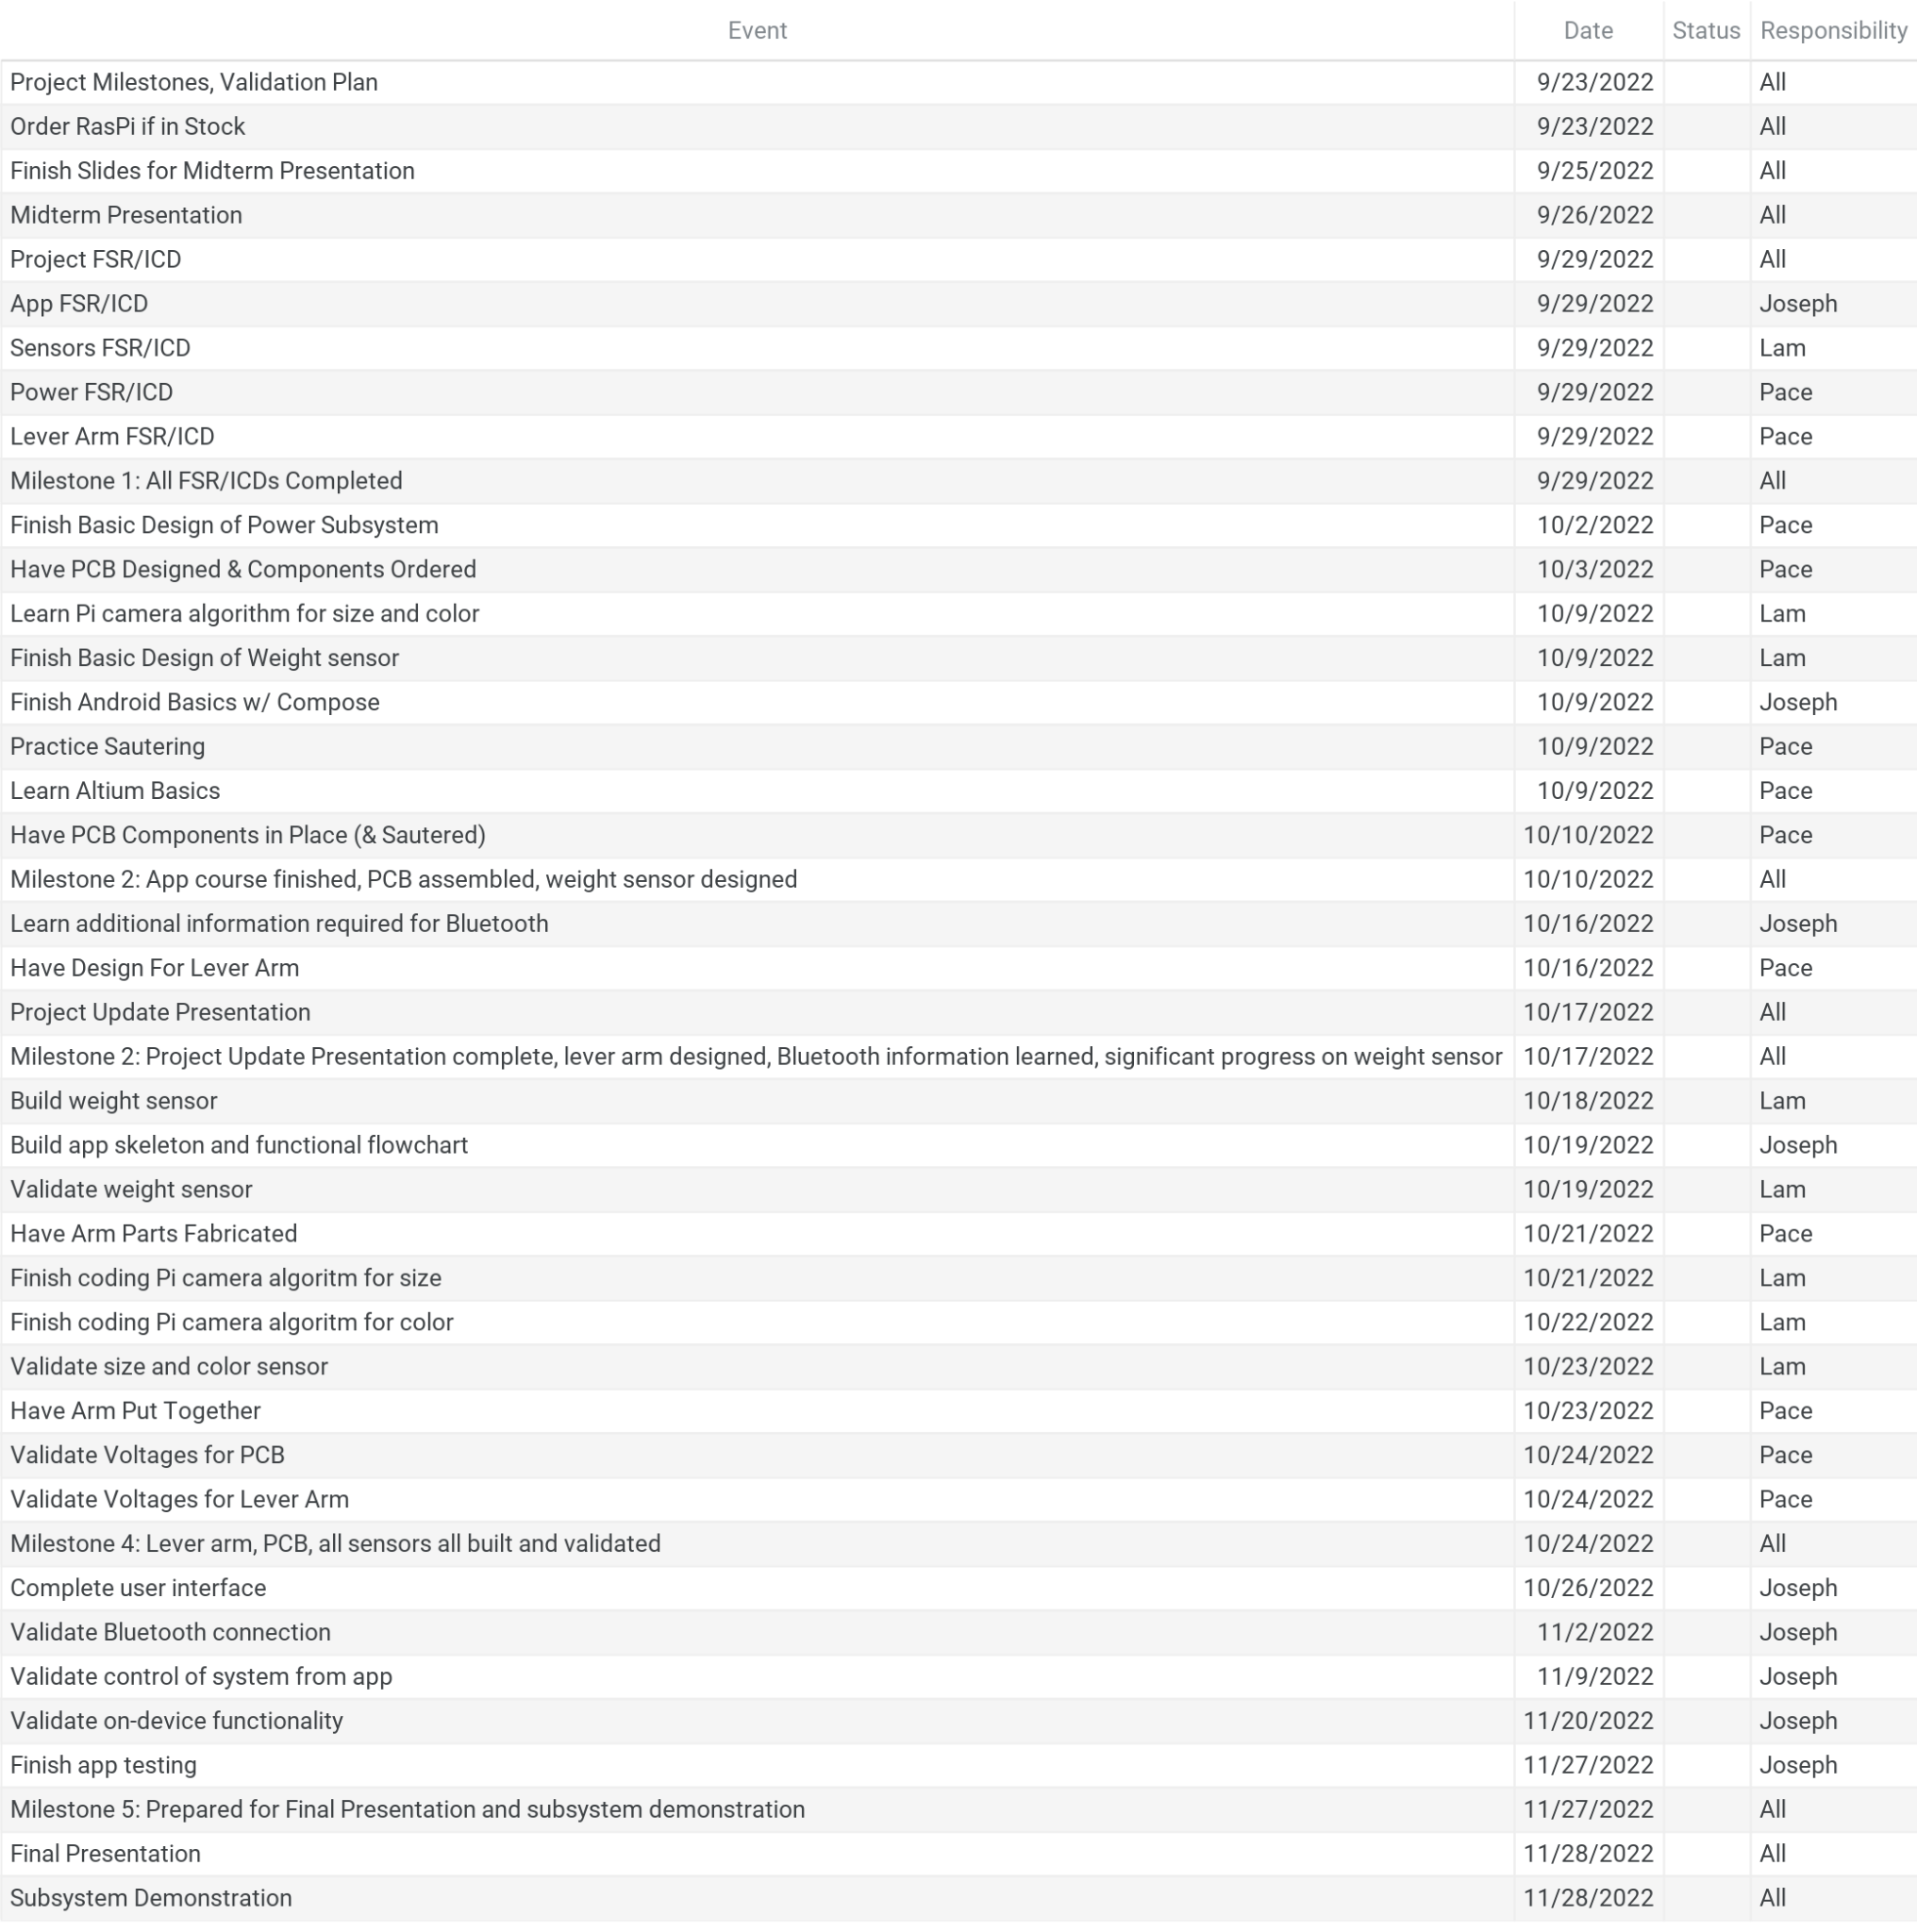
Execution plan

Slide 11
Validation plan
Subsystem | Test Name | Success Criteria | Methodology | Status | Responsibility
App | Boot Functionality | A skeleton version of the app (few to no features) successfully boots on a physical Android device and does not crash. | The skeleton app will be created and compiled using Android Studio and any relevant tools. It will then be loaded onto a Galaxy Tab S6 Lite and test booted. | Incomplete | Joseph
App | Specification Sorting | The app successfully allows the user to configure and store two "bin conditions". Attempting to set a value outside of the sensors' abilities returns an error. | The tester will attempt to store two "normal" (within bounds) bins with a cutoff at 3 inches diameter. They will then attempt to classify a cutoff with a fruit size of 0, which should fail. They will then try to store a fruit with a size greater than the maximum sensor area, which should fail. | Incomplete | Joseph
App | Bluetooth Connection | An Android device successfully connects to the Bluetooth-enabled microcontroller. | The microcontroller will be turned on and set to pair with a Bluetooth device. The Galaxy Tab will then be used to pair with the device. The device will be left for two minutes to ensure that the connection does not drop. The tablet will then be disconnected and reconnected to ensure that the microcontroller remains available for connection. | Incomplete | Joseph
App | Bluetooth Configuration | The app successfully passes a sorting configuration to the microcontroller. | The sorting configuration from the Specification Sorting test will be saved in the app and sent to the Bluetooth-enabled microprocessor aboard the physical Robotic Sorting System. The output of the processor will then be examined to determine if the configuration was stored. | Incomplete | Joseph
App | Belt Start/Stop | The app passes a command to stop and start the belt. | A test function will be added to the app that allows the app user to directly stop and start the belt. This system will then be tested to ensure that stopping/starting the belt in the app results in the appropriate action on the conveyor belt. | Incomplete | Joseph
App | Belt Auto-Stop | If a fruit has not been detected for 15 seconds, the belt stops and the app returns a notification. | A routine will be added to the microprocessor that checks to see if a fruit has been scanned in the last 15 seconds. A single fruit will be placed on the belt and scanned. The test will be successful if the belt stops and pushes a notification to the app 15 seconds after the fruit is scanned. | Incomplete | Joseph
App | Belt Movement Error | The app returns an error if the belt is obstructed or the power to the machine is cut off (stopping the belt). | The belt will be set to run, then the power will be disconnected at the wall. The test will be successful if the app returns a notification that the belt has stopped. | Incomplete | Joseph
App | Full Functionality | The app passes a configuration to the machine and starts the belt. When sorting is complete, the app stops the belt and returns a notification. | The sorting configuration from the Specification Sorting test will be passed to the sorting machine via the app. Two fruits (one for each bin) will be scanned on the belt and sorted. When 15 seconds have elapsed since the last fruit was scanned, the belt will stop and push a notification to the app. | Incomplete | Joseph
Power | PCB Voltages | Input power is correct (120V), conveyor belt receives correct voltage, microcontroller for lever arm receives correct voltage, RasPi recevies correct voltage | PCB will be tested with a voltmeter to check for the correct max voltage. This test will be done for all power inputs and outputs to validate that all the converters work correctly. | Incomplete | Pace
Lever Arm | Position Validation | Lever arm moves to correct position based off of the data from the sensors | Lever arm will be timed and the angle of the arm will be checked for accuracy. Lever arm must not only "aim" toward one of the channels but it must also aim toward the correct one based off of what fruit, and the quality of the fruit | Incomplete | Pace
Lever Arm | Timing Validation | Lever arm moves to correct position and stays there. Conveyor belt then turns on and lever arm does not move until it is required to do so again | Lever arm will be told a specific fruit and quality. From there, the timing will be checked to make sure that the subsystem waits for the information before moving. The lever arm will also be validated as staying at the correct position for the amount of time needed to move the fruit to the correct channel on the conveyor belt. | Incomplete | Pace
Power | Raspberry Pi Power | Validate Raspberry Pi receives correct voltage and turns on. Also validate that raspberry pi camera turns on. | Voltages will be tested with a voltmeter to ensure the correct max voltage | Incomplete | Pace
Weight sensor | Weight sensing Validation | Validate weight sensor is connected to the Raspberry Pi. Validate that the weight measurement is display. Validate that the measurement is accurate with a few degree of error. | Voltages from the load cell will be tested with a voltmeter. Check if the load cell is connected to the correct pinouts of the RasPi. Connect the RasPi to a computer. Check if measurement is displayed on the computer. Place object on the load cell and record the data. Weight the same object with a digit scale. Compare the two data. Repeat this process with different weighted objects. Adjust calibration or edit code if necessary. | Incomplete | Lam
Color sensor | Color sensing Validation | Validate that the camera(s) is connected to the Raspberry Pi. Validate that the RGB value is display. Validate that the RGB value match with the color. | Check if RGB value is displayed on the computer. Place an object in front of the camera and record RGB value. With RGB to color website, type in the value and check if color from the website matches with the color of the actual object. Repeat the process with objects with different colors. Adjust calibration or edit code if necessary. | Incomplete | Lam
Size sensor | Size sensing Validation | Validate that the camera(s) is connected to the Raspberry Pi. Validate that the size measurement is display. Validate that the size measurement is accurate with a few degree of error. | Check if measurement is displayed on the computer. Place an object in front of the camera and record height and width. Measure the height and width of the same object with a ruler.. Compare the two data. Repeat this process with different size objects. Adjust calibration or edit code if necessary. | Incomplete | Lam

